Slide 1


WELCOME
TODAY’S WEBINAR is:
How to Scan other Paper Documents
My name is Sherrie
Email: Sbeek@etfile.com
Training Specialist and Client Advocate
Phone: (508) 475-4502
Technical Support: 1-888-672-7737 option 3
www.etfile.com

Slide 2
Administration Training for Auto Dealers
Section 1: Getting Started
Webinar Objectives:
At the completion of this Webinar, you will be able to:
      Decide how to configure your etfile workflow
      Create Cabinets and set permissions
      Describe the ways to import files
      Create Document Descriptions
      Add Contacts or send us a file to upload
www.etfile.com

Slide 3
Administration Training for Auto Dealers
Section 1: Getting Started
How to get documents into etfile
        Drag and Drop to the inbox or Folder in Cabinet
        Send to From Outlook (Dec. 2 Webinar)
        Right Click Send to etfile
        Print to etfile
        Scan to etfile
www.etfile.com

Slide 4
Administration Training for Auto Dealers
Section 1: Getting Started
Items to consider before you file your Documents
        Who can see the documents?
        Create the Cabinets and set permissions
        How do you want to find the documents, search by contact or keywords, folder structure (best for documents you may not need to access often or have many of)
        Add Contacts Manually or have us import list
        Create Descriptions based on your type of documents and how you want to search
www.etfile.com

Slide 5
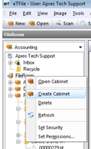
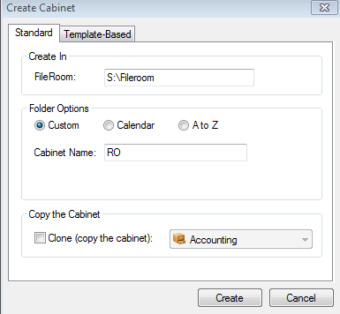
Administration Training for Auto Dealers
Section 5: Creating Cabinets and Setting Permissions
  To Create a Cabinet:
  Right click on the FileRoom
  Choose Create Cabinet
  3. Type in a Cabinet Name and click Create
Each customer has one FILEROOM
www.etfile.com

Slide 6
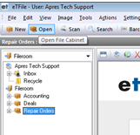
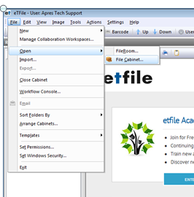
Administration Training for Auto Dealers
Section 5: Creating Cabinets and Setting Permissions
  To Open a Cabinet.
  Select the OPEN icon on the top menu
  OR choose File-Open-File Cabinet
Each customer has one FILEROOM
www.etfile.com

Slide 7
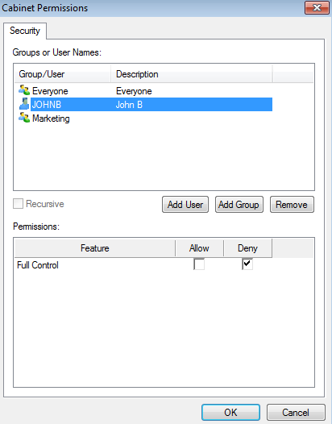
Administration Training for Auto Dealers
Section 5: Creating Cabinets and Setting Permissions
Each customer has one FILEROOM
Select the Group or User on the top and then choose either Allow or Deny –repeat this for each User or Group you added
Select Ok when done setting permissions
www.etfile.com

Slide 8
Administration Training for Auto Dealers
Section 1: Getting Started
How to File
      Select the Inbox
      Click Scan on the Menu bar to scan your paper document
      Review scanned document
      Attach and Move the document
www.etfile.com

