Slide 1





WELCOME
TODAY’S WEBINAR is:
How to Properly Scan Repair Orders
My name is Sherrie
Email: Sbeek@etfile.com
Training Specialist and Client Advocate
Phone: (508) 475-4502
Technical Support: 1-888-672-7737 option 3
www.etfile.com

Slide 2
Administration Training for Auto Dealers
Section 1: Getting Started
Webinar Objectives:
At the completion of this Webinar, you will be able to:
      Describe the process of an etfile scan
      Discuss how etfile integrates with your Auto Dealer Database (such as, Automate)
      List the steps of an RO Template when scanning
      Follow the steps to scan RO’s to etfile
      Discuss troubleshooting techniques when scanning RO’s
      Describe the importance of the Scan Summary and what to do if you cannot fix an issue
www.etfile.com

Slide 3
Administration Training for Auto Dealers
Section 1: Getting Started
Common reasons why scan issues occur:
      Forgetting to review each scan summary to ensure it matches what they scan and if not stopping and fixing issue or calling us
      Smudges, lines or marks on page 1 or RO and not knowing how to fix or there is an issue, again not check summary
      Getting rid of hard copies or miss placing after scanning before they ensure it is scanned correctly,
      Not using Exception report to check their work
www.etfile.com

Slide 4
Administration Training for Auto Dealers
Section 1: Getting Started
Common reasons why scan issues occur:
      Scanning to the scan folder not cabinet
      Unchecking somehow scan dialog check boxes
      Not putting Page 1 first,
      Scanning in a new style RO or warranty copy
      Unchecking template
      Many RO’s into one .tif-
www.etfile.com

Slide 5
Administration Training for Auto Dealers
Section 1: Getting Started
How to scan to etfile procedure
    Page 1 of the RO must be the first paper the scanner scans in first.
    Look for “page 1” on the RO. It has to be scanned in right side up and not upside down or the page 1 will not be read as an RO.
    Select the RO Cabinet so there is a blue highlighted box around the cabinet name. DO NOT select the SCAN FOLDER within the RO Cabinet to scan to.
www.etfile.com

Slide 6
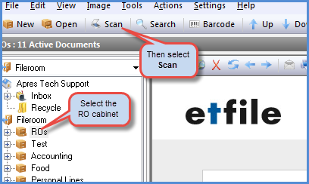
Administration Training for Auto Dealers
Section 1: Getting Started
4. With the RO Cabinet highlighted select the SCAN button on your menu bar.
www.etfile.com

Slide 7
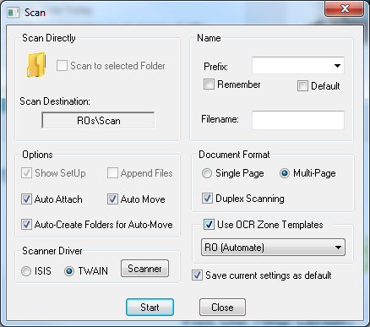
Administration Training for Auto Dealers
Section 1: Getting Started
5. Ensure the proper settings are set to scan in ROs.
6. When the Scanner Dialog appears be sure DUPLEX, 300 DPI and Black/White is selected and choose Scan or Start (or any customer settings saved during the install/training.)
www.etfile.com

Slide 8
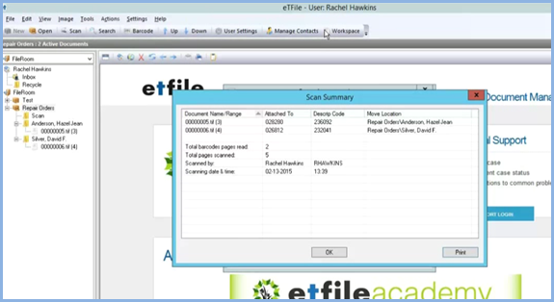
Administration Training for Auto Dealers
Section 1: Getting Started
MOST IMPORTANTLY CHECK THE SCAN SUMMARY EVERY TIME YOU SCAN!!
      Always compare the Scan summary with the RO’s you scanned.
      Check each RO against the Summary.
      Be sure the number of RO scanned matches the .tif files created, the pages (in parenthesis next to .tif file) and the Move location says the cabinetname\customername.
      If it says \Scan it did not work. Fix the issue or call Support!
www.etfile.com

Slide 9
Administration Training for Auto Dealers
Section 1: Getting Started
Run an Advanced Search to ensure you can find your RO if you are not sure.
Do not throw out or file in a box somewhere the RO you just scanned. Keep the hard copies to compare with your summary
Call support if you see ANY files in the SCAN FOLDER that are not sure of. : 1-888-672-7737 option 3 is our Technical Support Line.
www.etfile.com

